Slide 1


CMR TECHNICAL CAMPUS
UGC AUTONOMOUS
Accredited by NBA & NAAC with A Grade
Approved by AICTE, New Delhi and Affiliated to JNTU, Hyderabad.
DEPARTMENT OF COMPUTER SCIENCE AND ENGINEERING
MAJOR PROJECT
ON
ADVANCE SURVEILLANCE ROBOT WITH ROBOTIC ARM CONTROL OVER IOT
under the guidance of M.Sunitha
PRESENTED BY
Meghana Ankam(187R1A0564) Jayendra (187R1A0574) Ashritha Reddy(187R1A05A8) Lalitha (187r1a0563)

Slide 2



ADVANCE SURVEILLANCE ROBOT WITH ROBOTIC ARM CONTROL OVER IOT

Slide 3
ABSTRACT
Advance surveillance robot with robotic arm control over IOT
The present world everyone is in need about the safety due to increase in crime rate this has led to an increase in importance of surveillance system. Project is to design and build a manually controlled surveillance robot. The main purpose of the robot is to be able to roam around in a given environment while transmitting back real time data (video) to the ground station. This real time data can then be used by the controller (human) to move the robot around. This robot is mainly designed for army operations which has robotic arm in front to do pick and place operation and etc which is very useful for ARMY application and INDUSTRIAL applications. We are using Arduino a small credit card size computer which will control the robot directions and transmits the live real time video to ground station over IOT with Wi-Fi network for human for reducing his life from risk operations.
Meghana Ankam(187R1A0564) | Jayendra (187R1A0574)|Ashritha Reddy(187R1A05A8)|Lalitha (187r1a0563)

Slide 4
EXISTING SYSTEM
Advance surveillance robot with robotic arm control over IOT
In the existing system, Robotic arm in industries is only static because it is not integrated with moving vehicle due to which the robot is confined to same place and same work. The surveillance which provides living streaming to detect the obstacles were not present earlier that lead to make use of this robotic vehicle to shortest or the limited distance.
Meghana Ankam(187R1A0564) | Jayendra (187R1A0574)|Ashritha Reddy(187R1A05A8)|Lalitha (187r1a0563)

Slide 5

DISADVANTAGES
Advance surveillance robot with robotic arm control over IOT
Robotic arm with the Bluetooth connection covers only the shortest distance
Without the surveillance there will be no major use of the robot vehicle with the arm because there will no idea what obstacles will be present in the path.
Meghana Ankam(187R1A0564) | Jayendra (187R1A0574)|Ashritha Reddy(187R1A05A8)|Lalitha (187r1a0563)

Slide 6
PROPOSED SYSTEM
Advance surveillance robot with robotic arm control over IOT
Our aim is to control the robotic arm vehicle based on IOT using arduino. Arduino is used to make the robotic arm vehicle wireless. Robotic arm have DOF along with the gripper. The gripper will pick and place by means of the gear wheels. The base rotates in circular direction and forward, backward motion respectively. There is no limit to the movement each joint can produce since each joint is controlled by a DC motor. The DC motors will be used to control the robotic vehicle. Web camera is plugged into USB port of the arduino where USB ports are available. There is ESP 32 module available with camera interface to make it easy to use.
Meghana Ankam(187R1A0564) | Jayendra (187R1A0574)|Ashritha Reddy(187R1A05A8)|Lalitha (187r1a0563)

Slide 7
ADVANTAGES
Advance surveillance robot with robotic arm control over IOT
It can be used for military purpose for constant surveillance at border.
Robotic arm can pick up the items which are hazardous, harmful to humans.
Robotic arm can reduce the risks of the soldiers by picking up the suspicious items with the help of gripper
Robotic arm works in such a way environment where human interaction cannot be possible to do a particular job.
Meghana Ankam(187R1A0564) | Jayendra (187R1A0574)|Ashritha Reddy(187R1A05A8)|Lalitha (187r1a0563)

Slide 8
SOFTWARE REQUIREMENTS
Advance surveillance robot with robotic arm control over IOT
CODING LANGUAGE : Embedded C
OPERATING SYSTEM : Arduino
Meghana Ankam(187R1A0564) | Jayendra (187R1A0574)|Ashritha Reddy(187R1A05A8)|Lalitha (187r1a0563)

Slide 9
HARDWARE REQUIREMENTS
Advance surveillance robot with robotic arm control over IOT
Arduino
Motor driver/Motors ESP 32 module
Wi-Fi

Slide 10
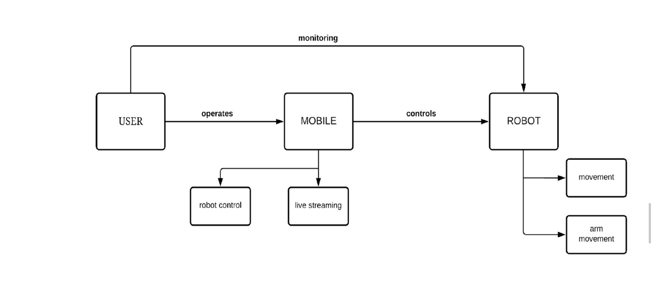
Advance surveillance robot with robotic arm control over IOT
PROJECT ARCHITECTURE

Slide 11
MODULES
Advance surveillance robot with robotic arm control over IOT
User
Mobile
Robot Vehicle

Slide 12
USER MODULE
Advance surveillance robot with robotic arm control over IOT
User can be army officer/industrialist who wants to use the robot
User controls the robot vehicle User can access live footage
Meghana Ankam(187R1A0564) | Jayendra (187R1A0574)|Ashritha Reddy(187R1A05A8)|Lalitha (187r1a0563)

Slide 13
MOBILE MODULE
Advance surveillance robot with robotic arm control over IOT
mobile module is an interface between user and robot vehicle
Forward, Backward, Left, Right Controls It includes live streaming

Slide 14
ROBOT VEHICLE MODULE
Advance surveillance robot with robotic arm control over IOT
Robot vehicle contains camera and wheels
It is controllable and movable
Small and unnoticable Works on wifi
Meghana Ankam(187R1A0564) | Jayendra (187R1A0574)|Ashritha Reddy(187R1A05A8)|Lalitha (187r1a0563)

Slide 15
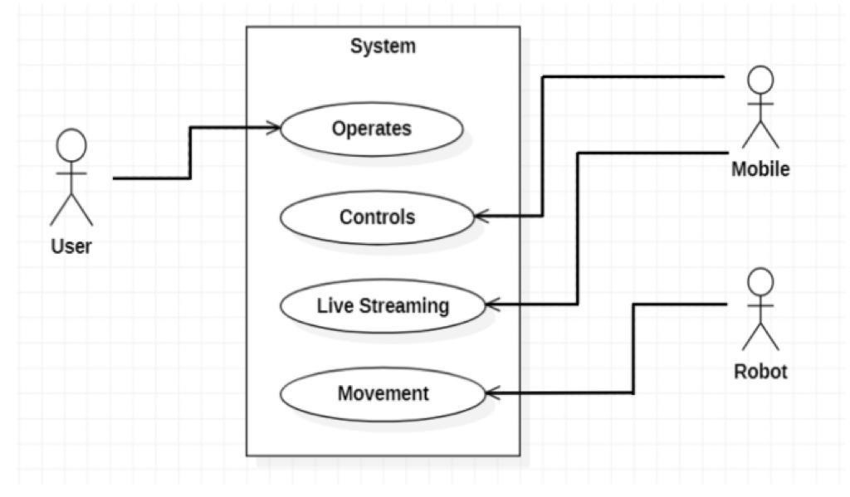
Advance surveillance robot with robotic arm control over IOT
USE CASE DIAGRAM
Meghana Ankam(187R1A0564) | Jayendra (187R1A0574)|Ashritha Reddy(187R1A05A8)|Lalitha (187r1a0563)

Slide 16
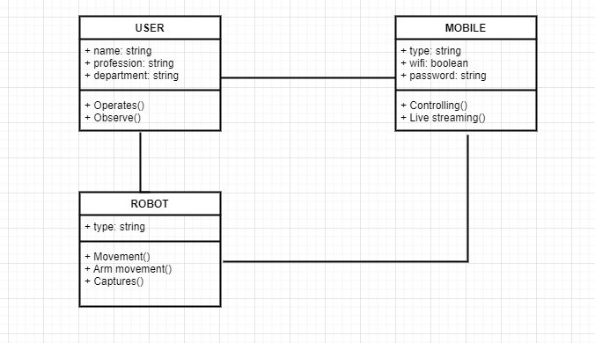
Advance surveillance robot with robotic arm control over IOT
CLASS DIAGRAM
Meghana Ankam(187R1A0564) | Jayendra (187R1A0574)|Ashritha Reddy(187R1A05A8)|Lalitha (187r1a0563)

Slide 17
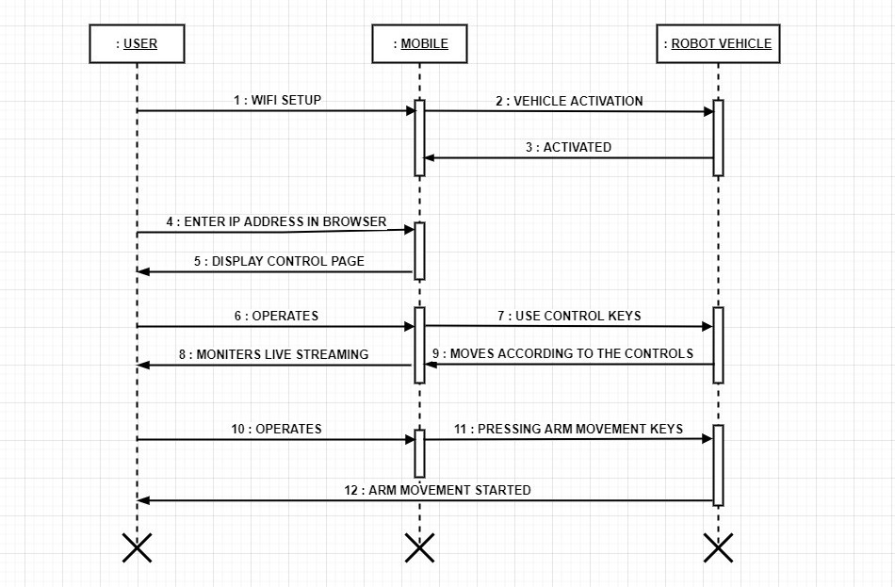
Advance surveillance robot with robotic arm control over IOT
SEQUENCE DIAGRAM

Slide 18
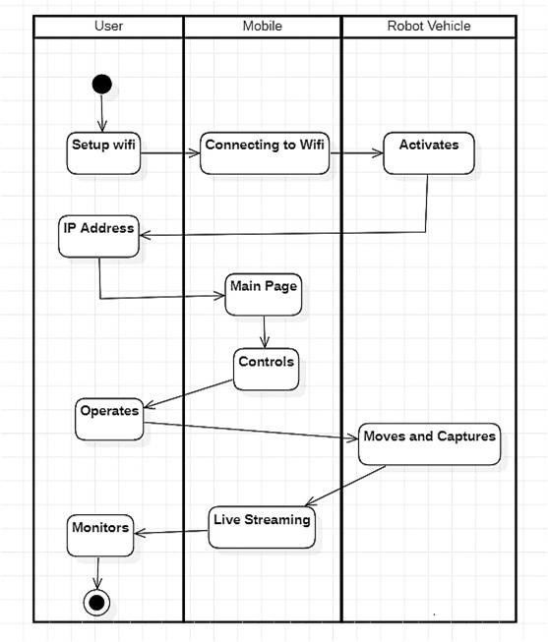
Advance surveillance robot with robotic arm control over IOT
ACTIVITY DIAGRAM

Slide 19
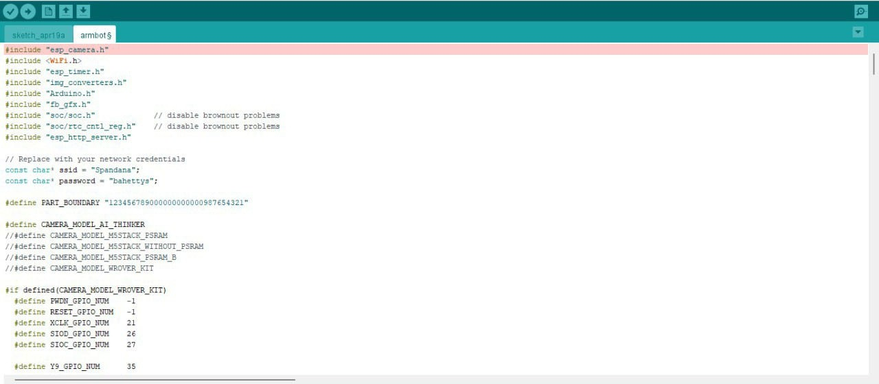
Advance surveillance robot with robotic arm control over IOT
SAMPLE CODE

Slide 20
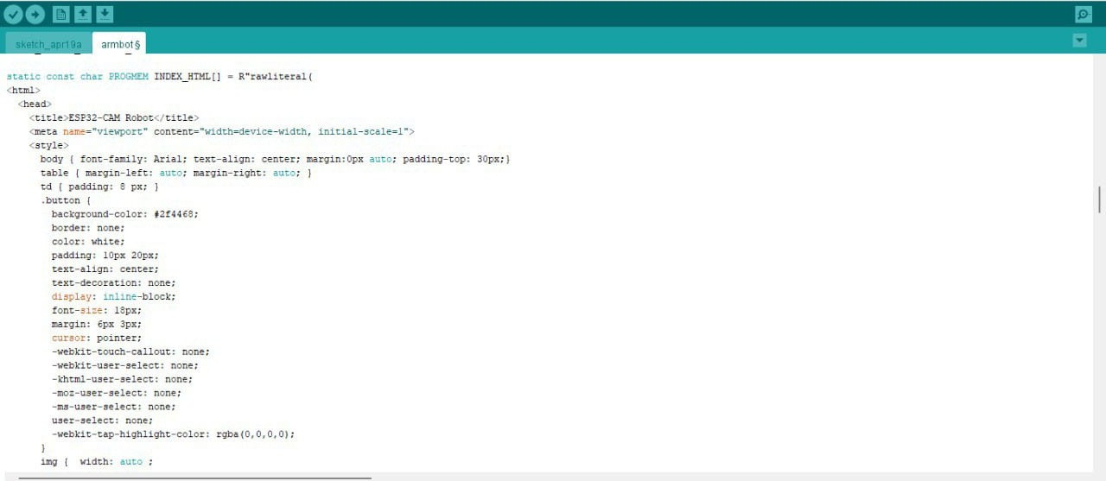
Advance surveillance robot with robotic arm control over IOT
SAMPLE CODE #2

Slide 21
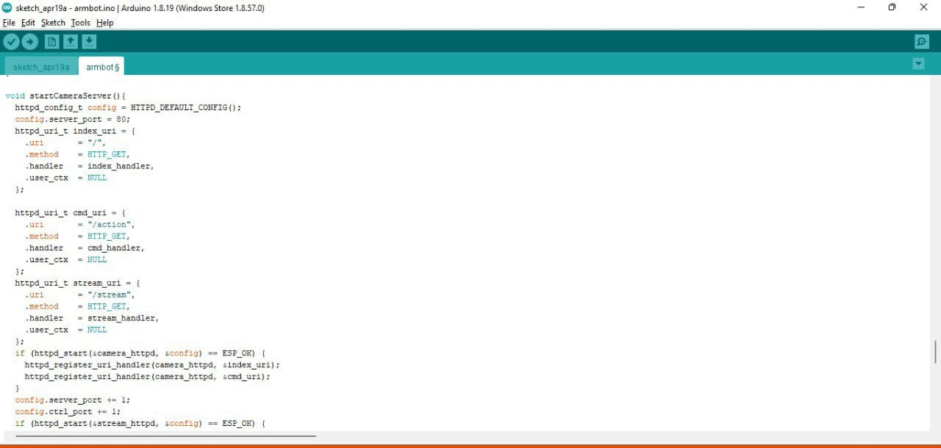
Advance surveillance robot with robotic arm control over IOT
SAMPLE CODE #3

Slide 22
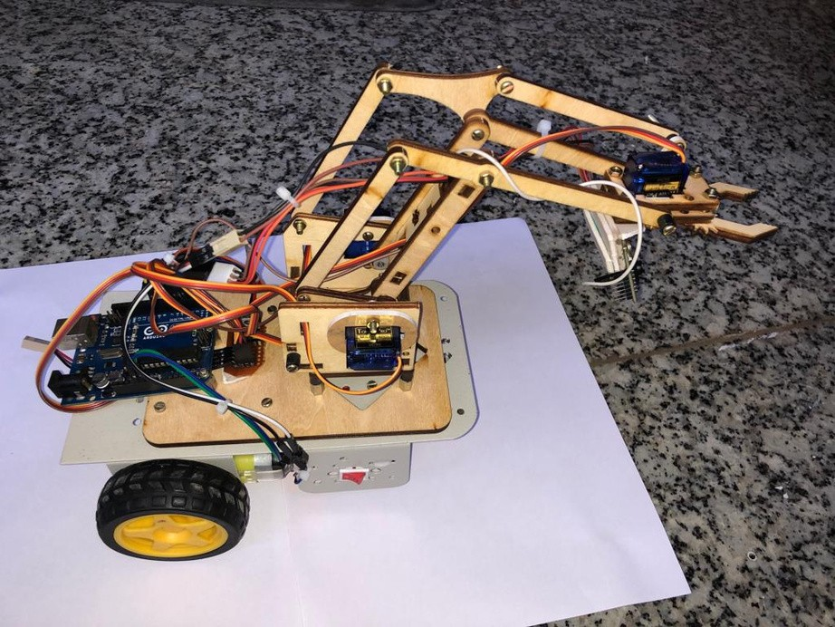
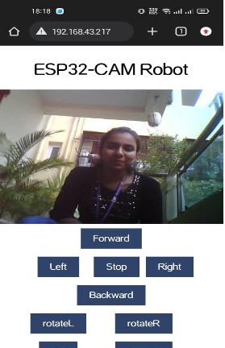
RESULTS
Advance surveillance robot with robotic arm control over IOT
Surveillance Vehicle with Arm
Mobile Control Interface

Slide 23
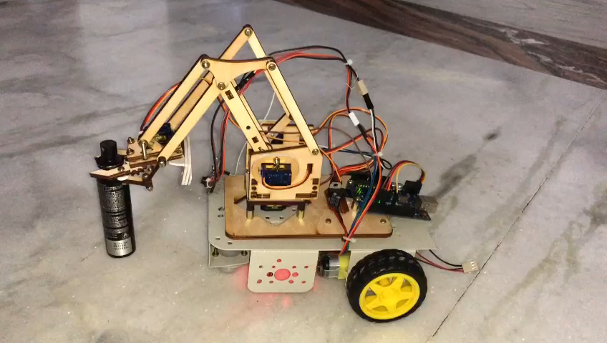
RESULTS
Advance surveillance robot with robotic arm control over IOT

Slide 24
CONCLUSION
Advance surveillance robot with robotic arm control over IOT
This project is very useful as compared to existing system, which will help to do multiple operations with robotic arm on top with high speed in multiple directions. This project can be further modified with IOT using arduino for autonomous fire vehicle which can go automatically to remote location with help of IOT

Slide 25
FUTURE ENHANCEMENT
Advance surveillance robot with robotic arm control over IOT
This is the first iteration of our project. In the future, our device's entire apparatus has the potential to become fully automated and a self-aware system capable of handling much more hazardous debris. The prospects for our device are limitless, as is the range of utility for our device. We hope to expand our design by implementing it in various research facilities and shortly institutes soon.

Slide 26

THANK YOU

